Slide 1
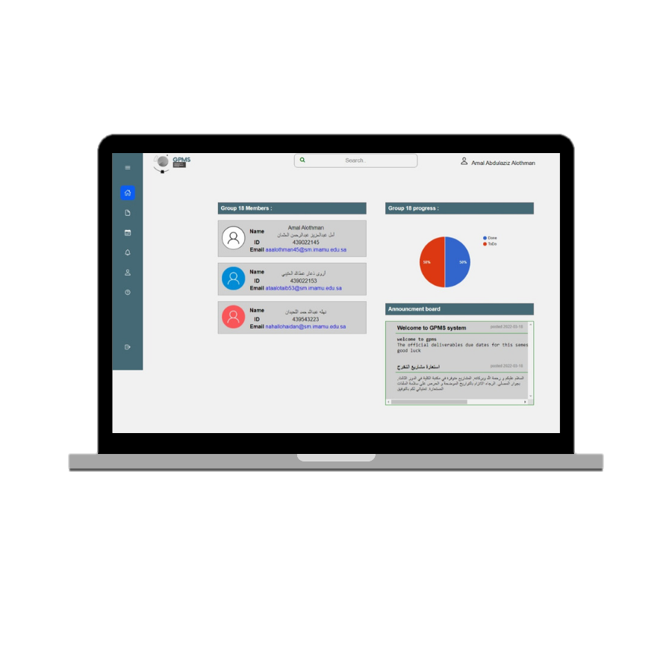
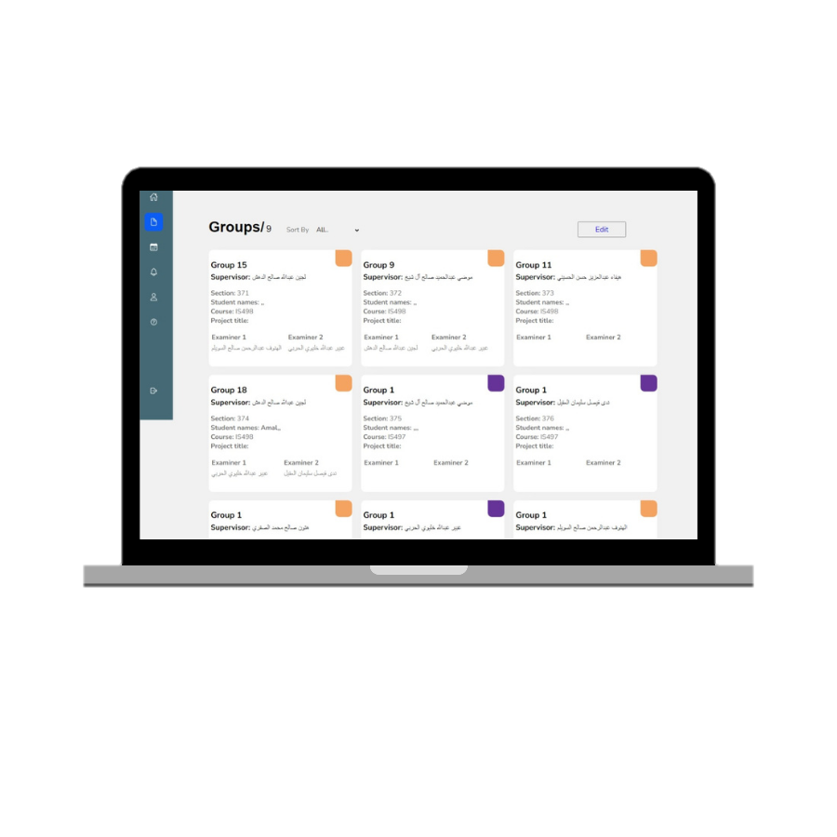
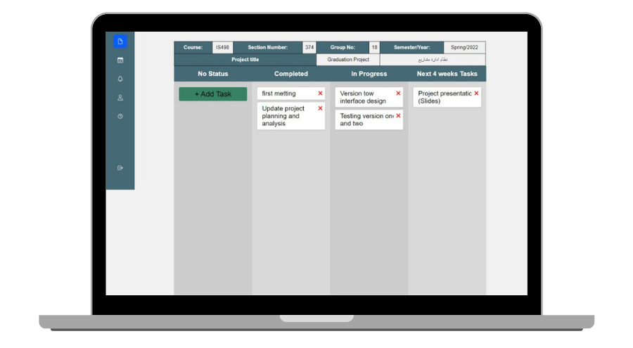
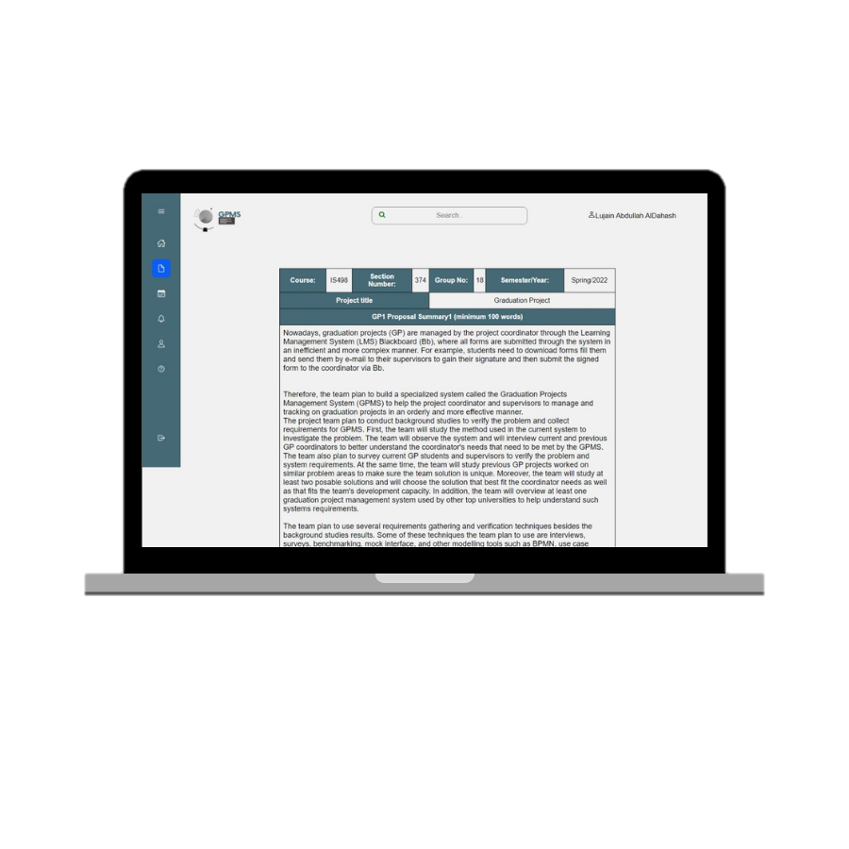
Graduation project management system
Amal Alothman , Arwa Thaar , Nahla Allohaidan
Supervisor: Dr. Lujain Aldahash
Introduction and Background
Result
Conclusion
IMSIU's current system does not provide adequate features to support GPs management process. So, this project aims to build a specialized system called Graduation Project Management System (GPMS) to help GP Coordinator and Supervisors manage and track GPs in an orderly and more efficient manner. The project team conducted background studies to analyze posable solutions, to overview current used systems and verify their problems. Then the team decided to create a management system website to save time and effort for coordinator, supervisors, and students.
Project team created the GPMS to assist GP Coordinators and Supervisors in managing and tracking GPs in a more ordered and productive way. The system automatically reminds students and supervisors of the required deliverables and deadlines. It also assisting the coordinator keeps track of activity on those deliverables. As illustrated in the results section the team where able to accomplish
To display the most students used in GPMS to display group members, group progress, announcement board. (figure. 1)
To shows for coordinator all the information of the groups with the supervisors, with the possibility of modification.(figure. 2)
Enable Student to update/add task with view supervisor review after submit. (figure. 3)
Enable supervisor to preview proposal summary of project and type supervisor review. (figure. 4)
Objectives
Figure. 1: Student Home Page
To manage IS female GPs in one integrated system
To help the coordinator track deliverable
To enable students effectively fill and submit deliverables electronically.
To save coordinator, supervisors and students time.
Future Work
Methodology
Figure. 2: Group details Page
When the project description is entered, it will be immediately translated.
The other team members are notified if one of the student is online
The system is used to fill out the report with all chapters.
The number of semester weeks is divided throughout the calendar page.
Providing online chat between users.
At the end of each semester, archive all deliverables.
1-Developing the system:
2-Collecting requirements
Acknowledgments
Observations
Mock interface
Figure. 3: Progress Report Page
The project team would like to thank each of Yousri Mohamed (software developer), and Ms. Nada Al-ogaiel (current GP coordinator). Finally, we'd want to express our gratitude to our families and friends for their continuing encouragement and support.
Interviews
Questionnaires
3-Collecting information
Interviews
Questionnaires
Reference
4-Tools used to develop the system
[1] A.dennis, B.Wixom , and D. Tegarden , System Analysis Design Uml version 2.0 an Object-Oriented Approach, 4th ed. Jhon wiley & sons, 2009.
[2] J.Alokluk, “The Effectiveness of Blackboard System, Uses and Limitations in Information Management”. Intelligent Information Management, p.133-149, 2018. [Online].Available:‏ https://doi.org/10.4236/iim.2018.106012. [Accessed: 25-oct-2021].
Visual studio
Brackets
Notepad++
Figure. 4: Proposal Summary Page
MAMP
PhpMyAdmin
CS/IS/IM/IT Department
1443-1444, Semester 2

