Slide 1
DC MOTOR

Slide 2
Introduction
The Dc machines are of two types namely DC generators and DC motors.
A DC generators converts mechanical energy into electrical energy whereas a DC motor converts the electrical energy into mechanical energy.
In order to understand the operating principle of a DC motor, it is necessary to understand how does a current carrying conductor experience a force, when kept in a magnetic field.

Slide 3
Windings in DC Machine
In any dc machines, there are two windings:
Field winding 2. Armature winding
Out of these, the field winding is stationary which does not move at all and armature winding is mounted on a shaft. So it can rotate freely.
Connection of windings for operation as motor:
To operate the dc machine as a motor, the field winding and armature winding is connected across a dc power supply.

Slide 4
DC Motor
Principle of operation:
When current carrying conductor is placed in a magnetic field, it experienced a force.
In case of DC motor, the magnetic field us developed by the field current i.e. current flowing in field winding and armature winding plays the role of current carrying conductor
So armature winding experienced a force and start rotating.

Slide 5
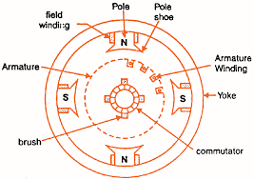
Construction of DC Motor
Fig.(1): construction of DC motor

Slide 6
Important parts of DC motor:
Yoke 4. Armature
Field winding 5. Commutator, brushes & gear
poles 6. Brushes
Yoke:
It acts as the outer support of a DC motor.
It provides mechanical support for the poles.

Slide 7
2. Poles:
pole of a dc motor is an electromagnet.
The field winding is wound over the poles.
Poles produces magnetic flux when the filed winding is excited.
3. Field winding:
The coils wound around the pole are called field coils and they are connected in series with each other to form field winding.
When current passing through the field winding, magnetic flux produced in the air gap between pole and armature.

Slide 8
4. Armature:
Armature is a cylindrical drum mounted on shaft in which number of slots are provided.
Armature conductors are placed in these slots.
Theses armature conductors are interconnected to form the armature winding.
5. Commutator:
A commutator is a cylindrical drum mounted on the shaft alonwith the armature core.
It collects the current from the armature conductors and passed it to the external load via brushes.

Slide 9
6. Brushes:
Commutator is rotating. So it is not possible to connect the load directly to it.
Hence current is conducted from the armature to the external load by the carbon brushes which are held against the surface of commutator by springs.

Slide 10
Back EMF
When the armature winding of a dc motor starts rotating in the magnetic flux produced by the field winding, it cuts the lines of magnetic flux.
Hence according to the faraday’s laws of electromagnetic induction, there will be an induced emf in the armature winding.
As per the Lenz’s law, this induced emf acts in opposite direction to the armature supply voltage. Hence this emf is called as the back emf and denoted by E_{b}.

Slide 11
Significance of back emf:
The presence of back e.m.f. makes the d.c. motor a self -regulating machine i.e., it makes the motor to draw as much armature current as is just sufficient to develop the torque required by the load.
When the motor is running on no load, small torque is required to overcome the friction and windage losses. Therefore, the armature current I_{a} is small and the back e.m.f. is nearly equal to the applied voltage.

Slide 12
2. If the motor is suddenly loaded, the first effect is to cause the armature to slow down. Therefore, the speed at which the armature conductors move through the field is reduced and hence the back e.m.f. Eb falls. The decreased back e.m.f. allows a larger current to flow through the armature and larger current means increased driving torque. Thus, the driving torque increases as the motor slows down. The motor will stop slowing down when the armature current is just sufficient to produce the increased torque required by the load.

Slide 13
3. If the load on the motor is decreased, the driving torque is momentarily in excess of the requirement so that armature is accelerated. As the armature speed increases, the back e.m.f. Eb also increases and causes the armature current Ia to decrease. The motor will stop accelerating when the armature current is just sufficient to produce the reduced torque required by the load. It follows, therefore, that back e.m.f. in a d.c. motor regulates the flow of armature current i.e., it automatically changes the armature current to meet the Load requirement.

Slide 14
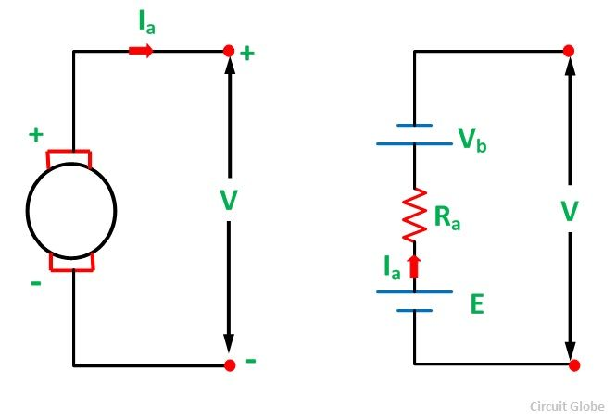
Voltage Equation of a DC Motor
Fig.(1):Equivalent circuit of DC motor

Slide 15
As shown in fig.(1), the armature supply voltage V has to overcome the opposition posed by the back emf E_{b} and some other voltage drops such as brush drop and the voltage drop across R_{a}.
From fig.(1), we can write that,
V = E_{b} + I_{a} R_{a} + V_{b} …….(1)
But voltage drop across brushes is negligible.
∴ V = E_{b} + I_{a} R_{a} ……(2)

Slide 16
Types of DC Motors
Depending on the way of connecting the armature and field windings of a d.c. motors are classified as follows:
DC Motor
DC series motor
Shunt motor
Compound motor
Separately excited motor
Short shunt compound
Long shunt compound

Slide 17
DC Shunt Motor
In DC shunt type motor, field and armature winding are connected in parallel as shown in fig.(1), and this combination is connected across a common dc power supply.
The resistance of shunt field winding (R_{sh}) is always much higher than that of armature winding (R_{a}).
This is because the number of turns for the field winding is more than that of armature winding.

Slide 18
The field current I_{sh} always remains constant. Since V and R_{sh} both are constant. Hence flux produced also remains constant. Because field current is responsible for generation of flux.
∴ ø ∝ I_{sh}
This is why the shunt motor is also called as the constant flux motors.

Slide 19
Fig.(1):DC shunt motor schematic diagram

Slide 20
DC Series Motor
In DC series motor, the armature and field windings are connected din series with each other as shown in fig.(1).
The resistance of the series field winding (R_{s}) is much smaller as compared to that of the armature resistance (R_{a}).
The flux produced is proportional to the field current. But in series motor, the field current is same as armature current.
∴ ø ∝ I_{a} or
∴ ø ∝ I_{s}

Slide 21
The armature current I_{a} and hence field current Is will be dependent on the load.
Hence in DC series motor the flux does not remains constant.
Fig.(1):DC series motor schematic diagram

Slide 22
DC Compound Motor
Long Shunt Compound Motor:
As shown in fig.(1), in long shunt dc motor, shunt field winding is connected across the series combination of the armature and series field winding.
2. Short Shunt Compound Motor:
In short shunt compound motor, armature and field windings are connected in parallel with each other and this combination is connected din series with the series filed winding. This is shown in fig.(2).
The long shunt and short shunt compound motors are further classified as cumulative and differential compound motors

Slide 23
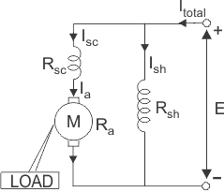
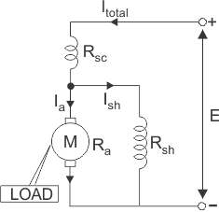
Fig.(1): Long shunt compound dc motor fig.(2):Short shunt compound dc motor

Slide 24
Torque & Speed Equations
Torque equations:
Torque produced by a motor will always be proportional to the air gap flux ø and the current flowing through the armature winding (I_{a}).
That means T ∝ ø I_{a}
The flux is produced by the field current hence ø will be proportional to field current. That means,
ø ∝ I_{field}
hence torque produced by a dc motor is proportional to the product of I_{a} and I_{field}. That means,
T ∝ I_{a} I_{field} ………..(1)
For various types of dc motors the expression for field current will be different. We will substitute them into eq.(1) to get the torque equations.

Slide 25
Torque equation of DC shunt motor:
For DC shunt motor Ifield = V/ R_{sh} = constant
Hence the flux ø is constant.
∴ T ∝ I_{a} ……..(2)
Hence in dc shunt motor, torque is proportional to only to the armature current.
2. Torque equation DC series motor:
For DC series motor, the field current is equal to the armature current i.e. I_{field} = I_{a}.
Hence T ∝ I_{a} I_{a}
∴ T ∝ I_{a}² ………(3)
Hence in dc series motor, torque is proportional to the square of armature current.

Slide 26
Speed Equations:
We know that the expression for the back emf is,
But P, Z and 60A are constants. Therefore we can write that,
E_{b} ∝ ø N ……(4)
Therefore the speed can be expressed as,
N ∝ E_{b}/ ø …….(5)
N = k E_{b}/ ø ………(6)
But V = E_{b} + I_{a} R_{a}
∴ E_{b} = V - I_{a} R_{a} ………..(7)
Substituting eq.(7) into eq.(5) we get,
N ∝ (V - I_{a} R_{a}) / ø …….(8)
Since ø ∝ I_{field} , we can write,
N ∝ (V - I_{a} R_{a}) / I_{field} …….(9)

Slide 27
DC shunt motor:
For dc shunt motor, the flux ø is constant.
∴ N ∝ (V - I_{a} R_{a}) …..(10)
2. DC series motor:
For dc series motor I_{field} = I_{a}. Therefore
N ∝ (V - I_{a} R_{a} - I_{s} R_{s}) / I_{a} …….(11)
where E_{b} = V - I_{a} R_{a} - I_{s} R_{s}

Slide 28
Applications of DC Motor
Shunt motor applications:
Various machine tools such as lathe machines, drilling machines, milling machines etc.
Printing machines
Paper machines
Centrifugal and reciprocating pumps
Blowers and fans etc.

Slide 29
2. Series motor applications:
Electric trains
Diesel-electric locomotives
Cranes
Hoists
Trolley cars and trolley buses
Rapid transit systems
Conveyers etc.

Slide 30
3. Cumulative compound motor applications:
Elevators
Rolling mills
Planers
Punches
Shears
4. Differentials compound motors applications:
The speed of these motors will increase with increase in the load, which leads to an unstable operation.
Therefore we can not use this motor for any practical applications

Slide 31
Specifications of DC Motor
Some of important specifications of a DC motor:
Output power in horse power(H.P.)
Rated voltage
Type of field winding
Excitation voltage
Base speed in RPM
Current
Frame size
Rating

