Slide 1
Optimal edge preserving restoration with
efficient regularization
Seminar
By
Dr. M. Arfan Jaffar
Mohsin Bilal, M. A. Jaffar, Optimal edge preserving restoration with efficient regularisation, The Imaging Science Journal, 63(2):68-75. 2015 (indexed by ISI Impact Factor 0.598).

Slide 2
Presentation Outline
Introduction:
  Spatial Degradations
Proposed Methods for SID
  Optimal Restoration with Regularization
Conclusion & Future Work

Slide 3
Introduction
During image acquisition, it is quite unavoidable to have a faithful representation of the scene to be recorded.
Hence every recorded image is more or less blurry.
Blurring is the linear process which spreads the scene information to the neighboring pixels; eventually, the loss of small scale details happens
Point spread function (PSF) is the general model that can result the
same blurring effect if an image is convolved with it.
Causes of Blurring: imaging technology limitation of resolution and recording speed.
Atmospheric turbulence, camera or object motion during recording, object occurrence outside the depth of field of recording device, all these situations yield blur, motion blur and out of focus blur respectively in the recorded image.

Slide 4
Introduction – Image Restoration
To deal with images degraded with blur, noise or both.
Image restoration attempts to obtain the original image given the degraded image with some knowledge of degradation factors
Image Restoration of spatial degradations is an interesting field providing challenging problems.
  Optimization of the ill-posed inverse problem
  Dealing with conflicting objectives - making a tradeoff between smoothness and sharpness.
Degraded Image
Formulation of Degradation Model
Information about Image Acquisition
Degraded Image
Inverse Degradation Process
Estimated Image

Slide 5
Spatial Degradations
Common degradations are blur, noise and motion.
Space invariant Degradation (SID) - Image suffers degradation with a single blurring kernel or Point Spread Function (PSF).
Space Variant Degradation (SVD) - different spatial locations suffer different form of degradation i.e. different spatial locations have different PSF.
Generally, caused by problems with the imaging system such as distortions in optical system, global lack of focus, object being outside the depth of camera’s field or camera motion
Notes:
Astigmatism, coma and rotary motion blur

Slide 6
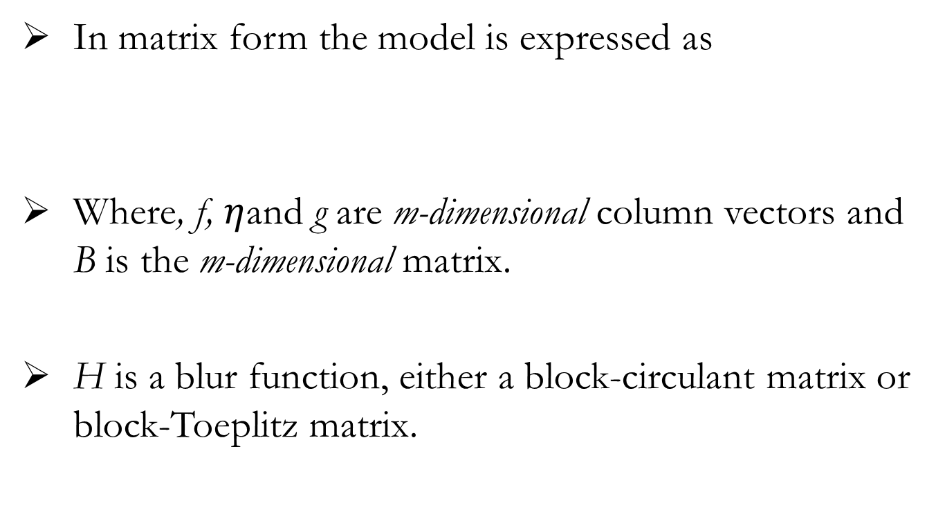
Space invariant Degradation Model
In matrix form the model is expressed as
Where, f, $η$and g are m-dimensional column vectors and B is the m-dimensional matrix.
H is a blur function, either a block-circulant matrix or block-Toeplitz matrix.

Slide 7
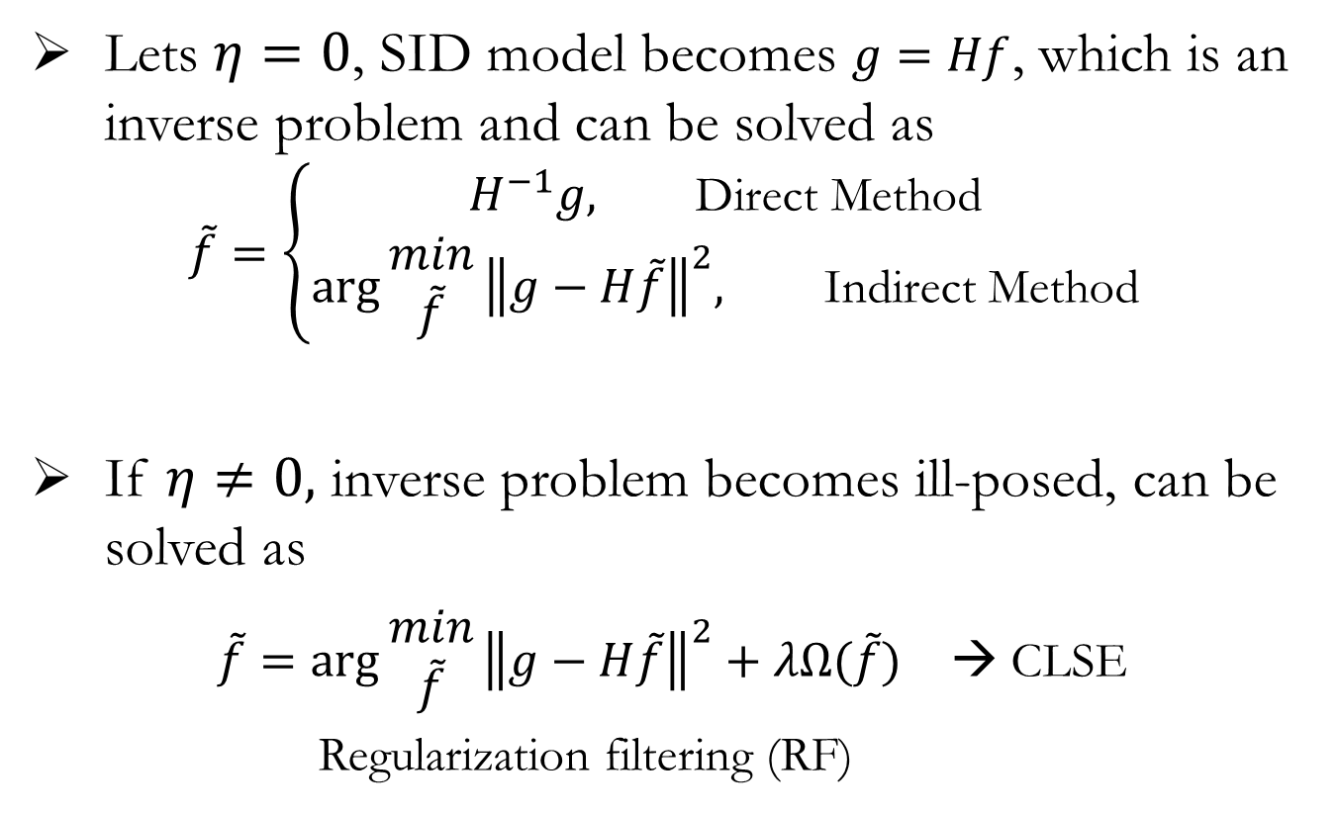
Restoration of SID
Lets $η=0$, SID model becomes $g=Hf$, which is an inverse problem and can be solved as
$$\tilde{f}=\left\{\begin{aligned}H^{−1}g, \text{Direct} \text{Method} \\ \arg{\begin{aligned}min \\ \tilde{f}\end{aligned}}{\left\|g−H\tilde{f}\right\|}^{2}, \text{Indirect} \text{Method}\end{aligned}\right.$$
If $η≠0,$ inverse problem becomes ill-posed, can be solved as
$\tilde{f}=\arg{\begin{aligned}min \\ \tilde{f}\end{aligned}}{\left\|g−H\tilde{f}\right\|}^{2}+λΩ(\tilde{f})$ → CLSE
Regularization filtering (RF)
Notes:
constrained least squares error

Slide 8
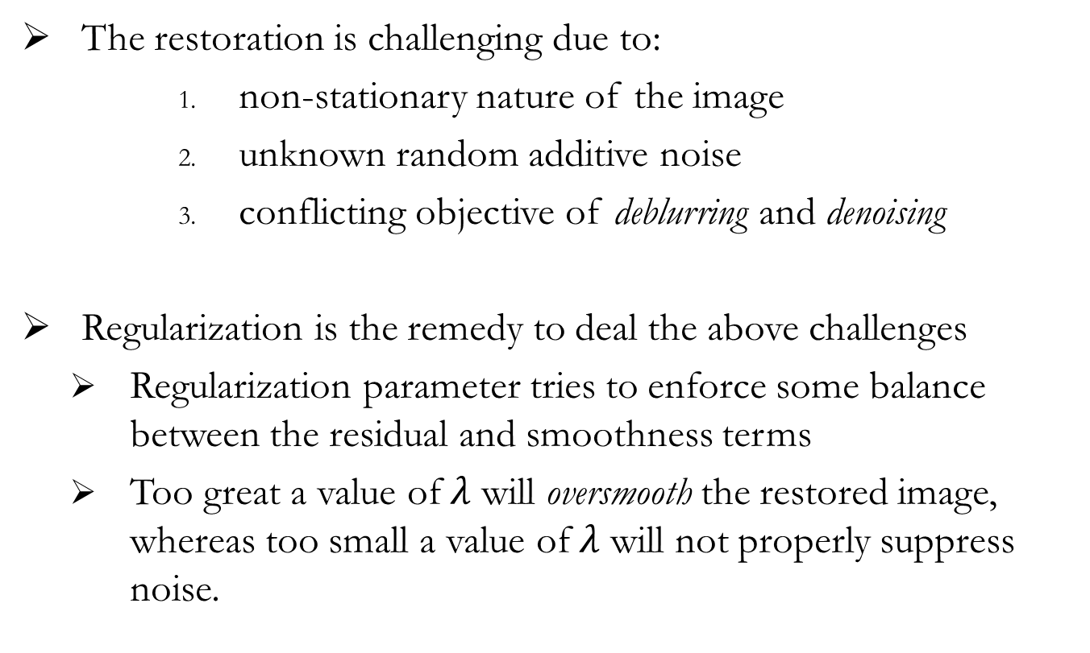
Adaptive Restoration via Regularization
The restoration is challenging due to:
        non-stationary nature of the image
        unknown random additive noise
        conflicting objective of deblurring and denoising
Regularization is the remedy to deal the above challenges
  Regularization parameter tries to enforce some balance between the residual and smoothness terms
  Too great a value of$λ$ will oversmooth the restored image, whereas too small a value of$λ$ will not properly suppress noise.

Slide 9
Proposed Regularization
Regularization term:
  Difference of every gray value with the average of all gray values in the estimated solution.
where x is the m-dimensional vector of the estimated image, and xp is the grey value of pixel at location p in the estimated solution x.
The regularization parameter : is a ratio between fidelity term (the difference between the estimated solution with the degraded image) and the proposed regularization term, (the difference of every pixel with the average of all grey values)

Slide 10
Restoration by Optimization
In order to search for the optimal solution, a gradient based approach is used based upon the idea of steepest descent, which searches for the estimate of x which minimized following error function
Restoration by searching global minima for:
The search is performed by steepest descent algorithm, which moves the estimate in the gradient direction:

Slide 11
Performance Measures
Most commonly used performance measures for Image Restoration include:
Signal-to-noise-ratio (SNR)
  Peak-signal-to-noise-ratio (PSNR):
    It is a global performance measure
    PSNR can be defined as

Slide 12
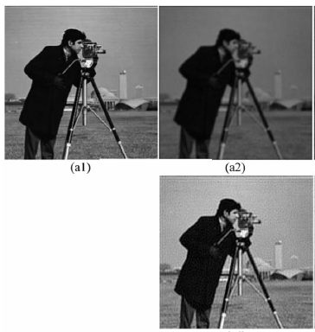
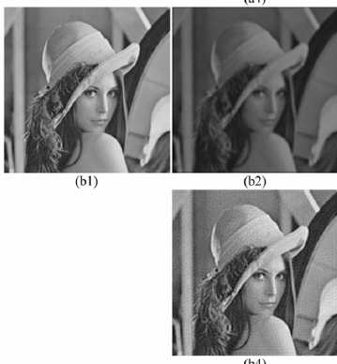
Results
Blur operator ‘H’ comprising of 3*3 Gaussian PSF kernel with the std ‘2’

Slide 13
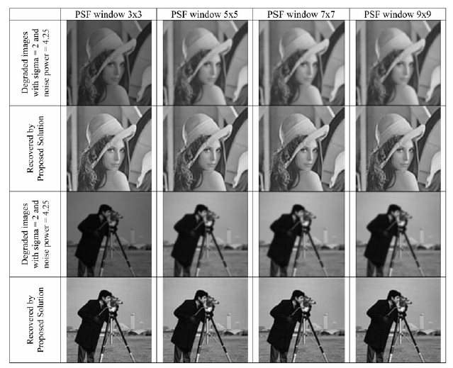
Result of proposed algorithm with varying PSF sizes

Slide 14

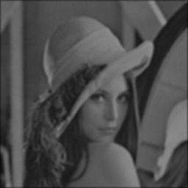

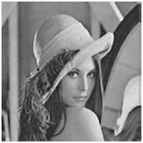
Experimental Results
(a)
(b), 8.22
(c), 16.03
(d), 16.93
(e), 19.45
(a) Original (b) Degraded (c) Neural Network (d) Mignotte and (e) Proposed Solution
Notes:
Degradation Parameters: Std Dev = 2, AWGN = 4.25

Slide 15
Comparative Analysis
Image Restoration Techniques | ΔSNR
Space Variant Adaptive | 2.07
HNN Algorithm | 5.94
Harmonic Algorithm | 6.49
Total Variation algorithm | 9.55
Spatially Adaptive Image Restoration | 5.27
Multiscale neural network Technique | 7.81
Biouscas – Dias | 8.10
Mignotte | 8.71
Proposed Solution | 11.43

Slide 16
Summary
An efficient gray scale average based regularization term is proposed for the smoothness of solution in objective function.
Restoration estimate is obtained iteratively by applying steepest descent approach.

Slide 17
Cross-Cultural Emotion Classification based on Incremental Learning and LBP-Features
Sultan Zia, M. A. Jaffar, Cross-Cultural Emotion Classification based on Incremental Learning and LBP-Features, Applied Mathematics & Information Sciences, 9, No. 5, 2651-2656 (2015)

Slide 18
Introduction
A number of studies have shown that facial expression representations are cultural dependent and not universal.
Most facial expression recognition (FER) systems use one or two datasets for training and same for testing and show good results.
While their performance mortify radically when datasets from different cultures were presented.
To keep high accuracy for a long time and for all cultures, a FER system should learn incrementally.
We proposed a FER system that can offer incremental learning capability.
Local Binary Pattern (LBP) Features are used for Region of Interest (ROI) extraction and classification.
We used static images of facial expressions from different cultures for training and testing.

Slide 19
Introduction
Automatic FER is still a challenging problem due to illumination, head pose, aging, glasses, cultures and races.
Even, human cannot 100% recognize facial expressions due to many reasons.
First, different people interpret expressions differently for example, fear expression images, which interpreted as fear in America and most of the other countries are mostly interpreted as surprise in Japan.
Second, people from different cultures think about facial expressions in different ways, for example, in some cultures, people focus on mouth but in others focus on eyes etc.
Third, in different cultures expressions are expressed in different ways i.e. not all the facial expressions are innate and universal.

Slide 20
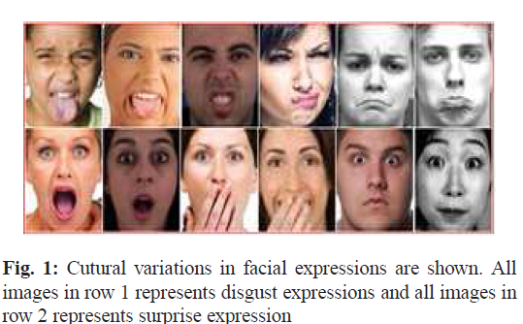

Slide 21
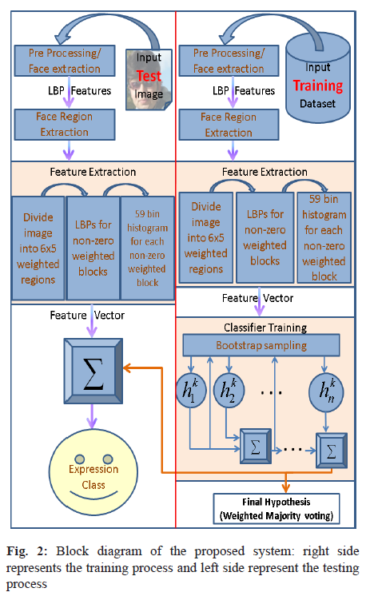

Slide 22
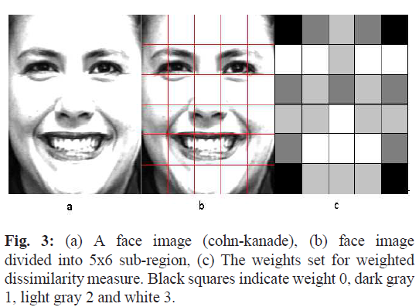

Slide 23
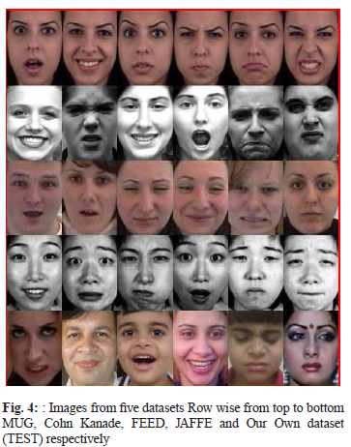
Five datasets used JAFFE, Cohn Kanade, MUG, FEEDTUM and our own dataset of colored images of Indian subcontinent people, movies and videos

Slide 24
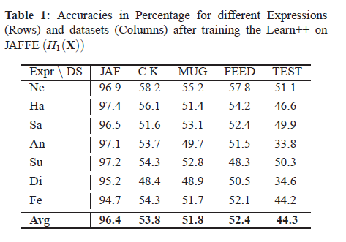
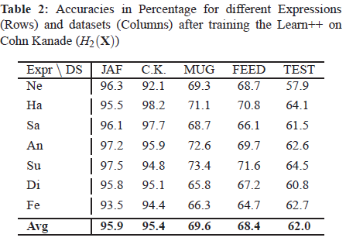
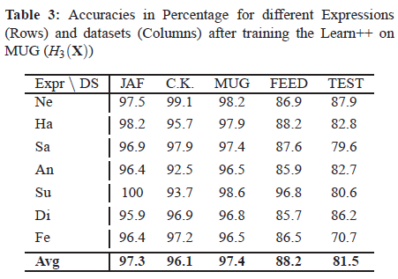
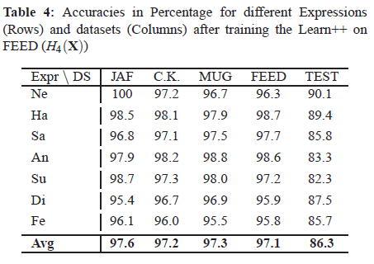

Slide 25
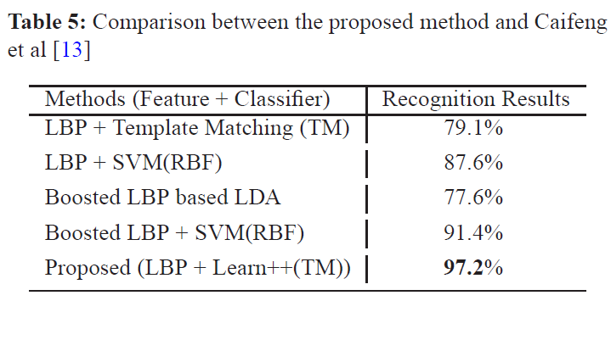

Slide 26
Conclusion
A proposed a method for automatic facial expression classification using incremental learning and local binary patterns histogram features.
The proposed system has ability to learn incrementally and can accommodate future data.
Due to incremental learning ability it can accommodate itself in different cultures.
The experimentation performed is showing promising results.

