Slide 1



The properties of mag etic materials and its Applications
Dr. Naglaa Abdel All
Assistant Professor
Imam University

Slide 2

The World of Mag ets

Slide 3


What is Magnetism?
Magnetism is the force of attraction or repulsion of a magnetic material due to the arrangement of its atoms, particularly its electrons.
Magnets have 2 Poles
Negative
Positive

Slide 4
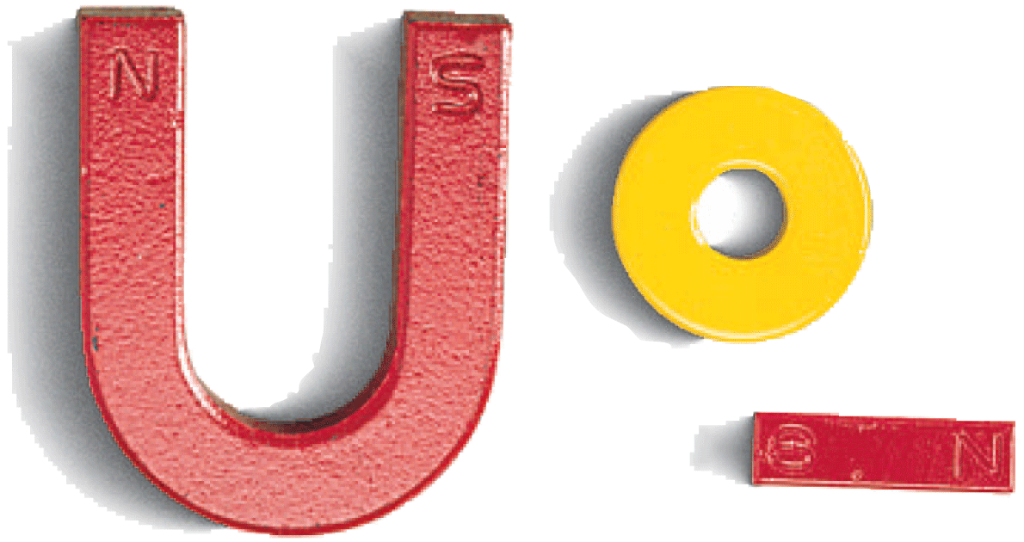
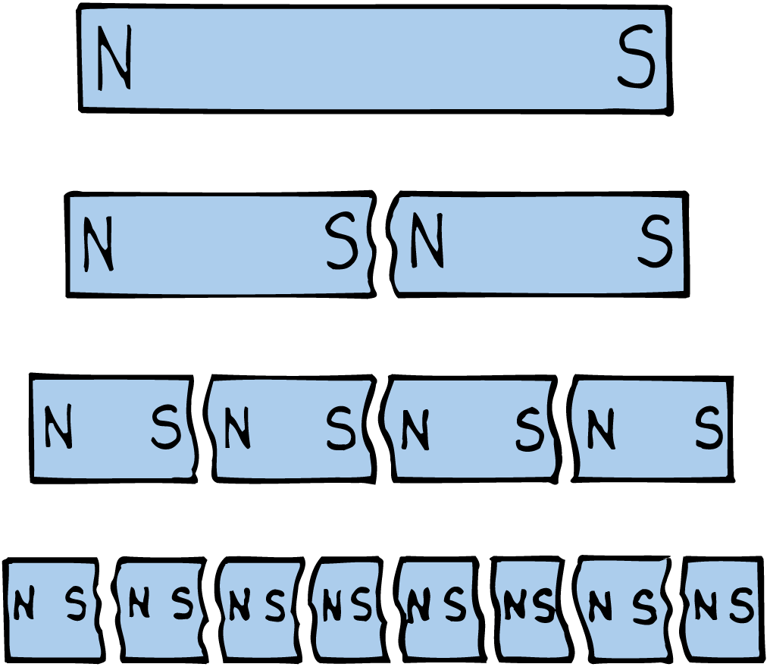
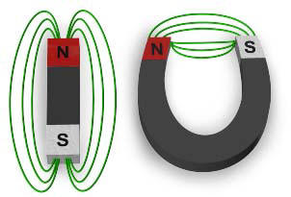
Magnetic Poles

Slide 5
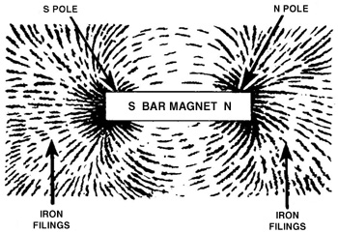

A Magnetic Field Is…
…THE AREA AROUND MAGNET
                …WHERE IT CAN ATTRACT OR REPEL THINGS

Slide 6
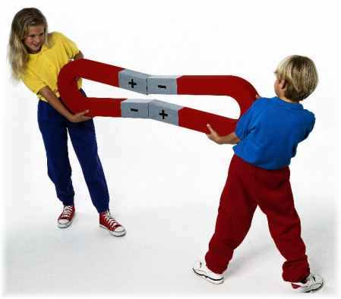



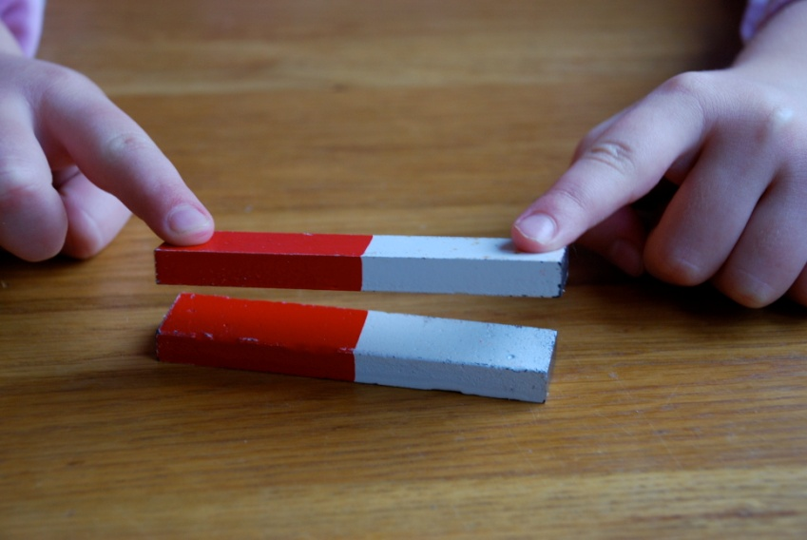

Opposites attract
(They “Hold Hands”)
Likes repel
(They “Ignore Each Other”

Slide 7

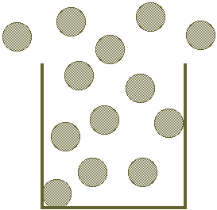
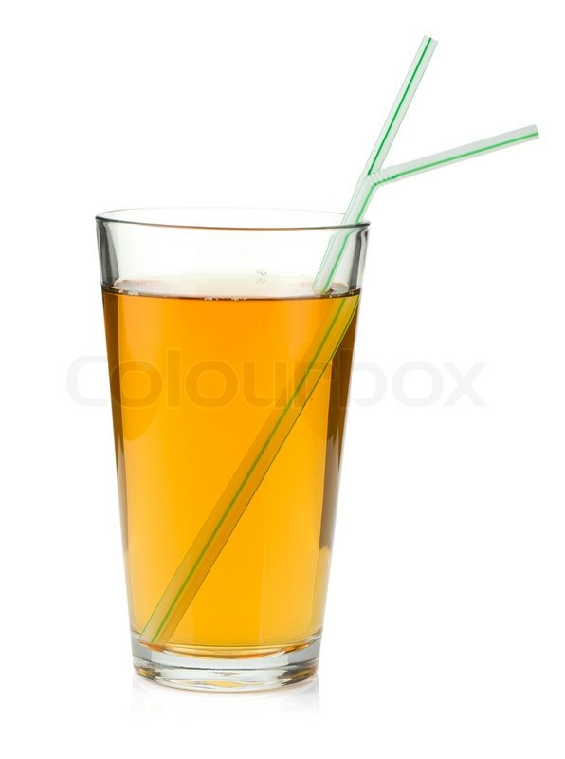

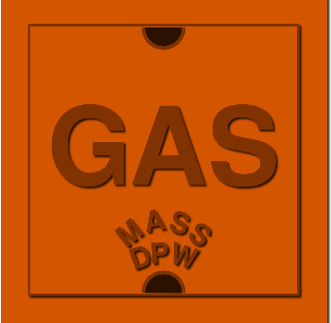
Magnets can pull through
…And liquids
gases

Slide 8
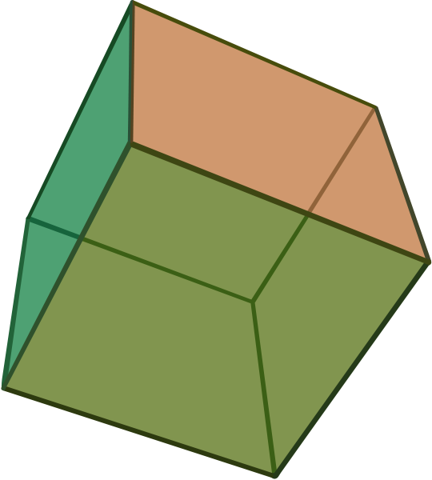
Some Magnets can pull through solids…

Slide 9

What Kinds of things are magnetic?
Lets find out!

Slide 10

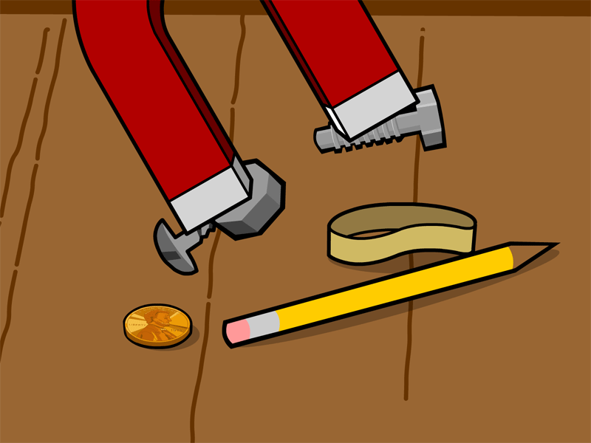


Using a ,walk around the room and find different things that are
MAGNETIC!
If They are magnetic, they will stick to the magnet

Slide 11


READY SET…GO!
Magnetization in Materials

Slide 12
Magnetization in Materials
Electron orbiting
around the nucleus
Magnetic Moments of Atoms
Orbital magnetic moment
Spin magnetic moments
Both of these electronic motions produce internal magnetic fields B.

Slide 13
Magnetization
Magnetization refers to the process of converting a non-magnetic material into a Magnetic material.
The intensity of Magnetization is directly related to the applied field H.

Slide 14

Magnets – how do they work?
N
S
Just what is happening inside the magnet to make it magnetic?

Slide 15
Magnets – how do they work?
We need to look closely at what is happening to the particles (electrons) inside the magnet.
N
S
Just what is happening inside the magnet to make it magnetic?

Slide 16
Magnets – how do they work?
We need to look closely at what is happening to the particles (electrons) inside the magnet.
N
S
Just what is happening inside the magnet to make it magnetic?
In an unmagnetized material, the tiny electrons, or atomic magnets point in random directions.

Slide 17
Magnets – how do they work?
We need to look closely at what is happening to the particles (electrons) inside the magnet.
N
S
Just what is happening inside the magnet to make it magnetic?
When the material becomes magnetized, more and more of the tiny atomic magnets line up with each other. They act as one BIG magnet.

Slide 18
Magnets – how do they work?
We need to look closely at what is happening to the particles (electrons) inside the magnet.
N
S
Just what is happening inside the magnet to make it magnetic?
If a magnet is hit with a hammer, the tiny atomic magnets get thrown out of line again, so the material becomes demagnetised.

Slide 19
Magnets – how do they work?
Temperature
We need to look closely at what is happening to the particles (electrons) inside the magnet.
N
S
Just what is happening inside the magnet to make it magnetic?
If a magnet is heated to high temperature, the tiny atomic magnets get thrown out of line again, so the material becomes demagnetised.

Slide 20
Classification of Magnetic Materials
1. Dia …
2. Para …
3. Ferro …
4. Anti Ferro …
5. Ferri …
Magnetic materials.

Slide 21
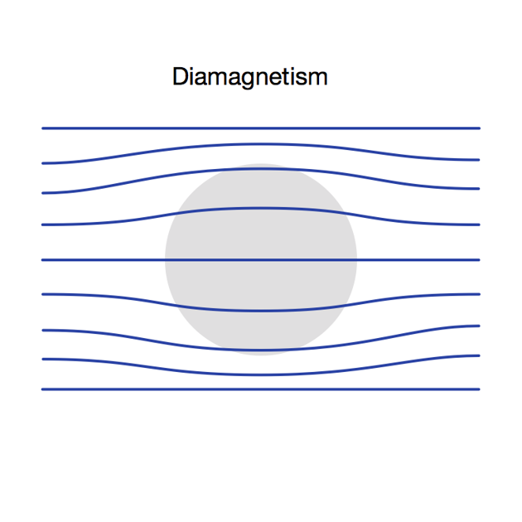
1. Diamagnetic materials
is a substance which create a magnetic field in opposite
to an externally applied field.
Diamagnetic
Always present, even when there are no permanent dipole moments on the atoms.
They repel the lines of force slightly.
Susceptibility is :
negative (-10⁻⁶ to -10⁻⁵)
Independent of temperature
H
The examples :
Bismuth, silver, copper and hydrogen.

Slide 22
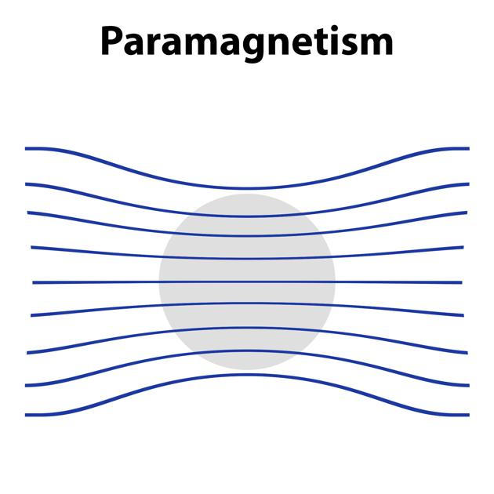
2. Paramagnetic materials
is a substance which very weakly attracted by the poles of a magnet, but not retaining any permanent magnetism.
paramagnetic
The properties of paramagnetic susceptibility
Positive (Typically 10⁻⁵ to 10⁻³)
Temperature-dependent
Saturates for large B or low T
H
They attract the lines of forces weakly.
Examples: Al, Pt, Ca, O₂ are such materials.

Slide 23
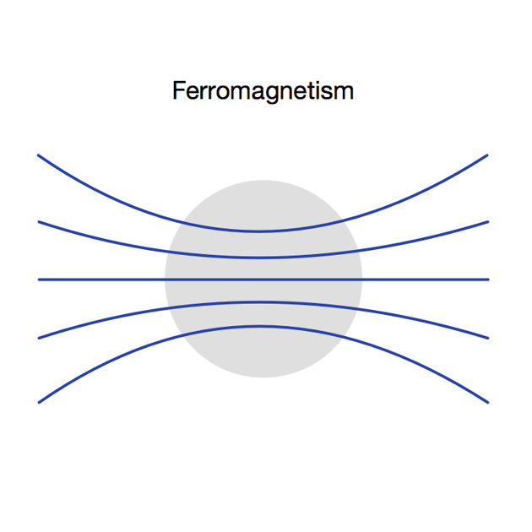
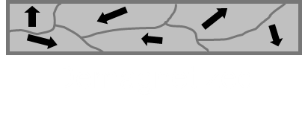
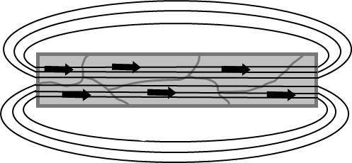
3. Ferromagnetic materials
A type of material that is highly attracted to magnets.
A ferromagnetic materials has a spontaneous magnetic moment.
have high susceptibility.
Magnetic saturation.
Ferromagnetic
H = 0
Temperature-dependent
Ferromagnetic materials are made up of many regions in which the magnetic fields of atoms are aligned.
[magnetic domains]
Examples: Fe, Co, Ni, Cr, Mn are such materials.

Slide 24
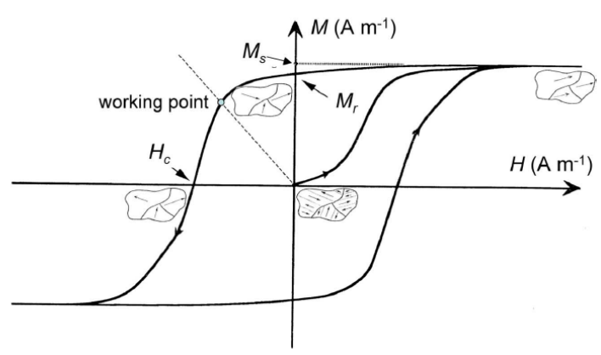
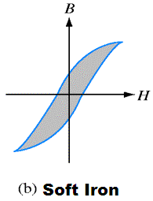
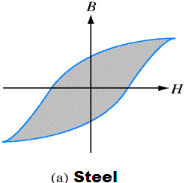
Hysteresis Loop
Magnetization measured as a function of applied magnetic field for a ferromagnetic material.
Soft magnetic materials
Hard magnetic materials
This property is called Hysteresis

Slide 25
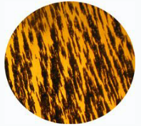
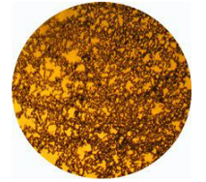
Effect of the applied magnetic field
Figure (1): Ferromagnetic particles under the influence of an external magnetic field.
Figure (2): Ferromagnetic particles in absence of an external magnetic field.

Slide 26
Curie temperature (T_{c})
The Curie temperature T_{c}, is the temperature above which the spontaneous magnetization of ferromagnetic materials are vanishes.
For :
T > T_{C} paramagnetism
T < T_{C} ferromagnetism
Note that the exchange field will become stronger as temperature is lowered,

Slide 27
4. Ferrimagnetism
The ferrimagnetism will give rise to spontaneous magnetisation then ordering occurs at T < Tc.
Example: Magnetite (Fe₃O₄)
At low temperatures:
N(0) is much smaller than that by considering Fe₃O₄ as ferromagnetic.

Slide 28
5. AntiFerromagnetism
The antiferromagnetism will not produce any magneisation because of the two opposing
spin components.
When we applied external field, the net magnetization will be different of zero due to that the maximum of spin are in the same direction.
Antiferromagnetism is a special case of ferrimagnetism.
Neel temperature (T_{N}) is the critical temperature for the antiferromagnetic materials

Slide 29
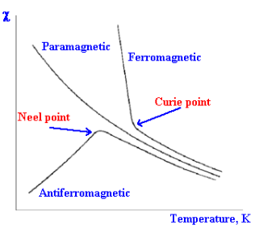
Effect of Temperature
Figure (2): Effect of temperature on magnetic materials.

Slide 30
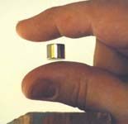
Applications :
Ferromagnetic materials
are used in magnetic recording devices, such as for cassette tapes, floppy discs for computers, and the magnetic stripe on the back of credit cards.
Diamagnetic materials
are used for magnetic levitation, where an object will be made to float in are above a strong magnet.

Slide 31
Magnetic soft materials:
are used in making electromagnets and these electromagnets are used in telephone receiver, bells, loud speakers etc.
Magnetic hard materials:
are used in making permanent magnets.

Slide 32

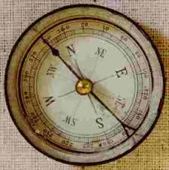
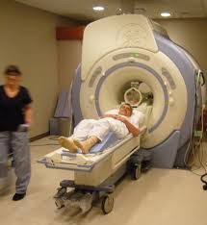
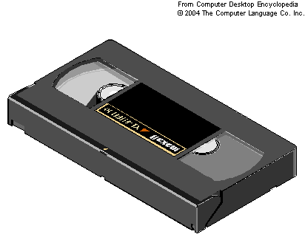
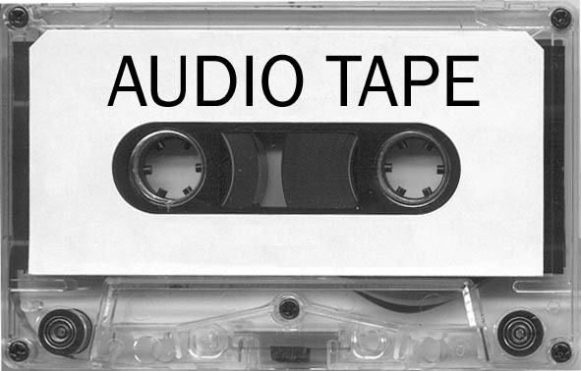
Applications of magnetic domains

Slide 33
The End…
Thank you

