Slide 1
Genetic Algorithm and SOM based Fuzzy Hybrid Intelligent Method for Color Image Segmentation
Research Seminar
Dr Arfan Jaffar
arfan.jaffar@ccis.imamu.edu.sa
Ahmad Khan, M. Arfan Jaffar, Color image segmentation: a novel spatial fuzzy genetic algorithm, Signal, Image and Video Processing, SPRINGER
8 (7), 1233-1243, 2014

Slide 6
SOM Initialization
Initialization plays an important role in the evolutionary algorithms and other iterative procedures.
It is generally performed by the user, using some sort of domain knowledge, or employing some random procedure.
Random initialization is not suitable because it does not explore the search space effectively and leads the clustering process to converge to a local optima [Celebi et al., 2013].
In this research the SOM network and genetic algorithm (GA) are initialized to the dominating colors, which are extracted from the peaks of color histograms of the input image.

Slide 7
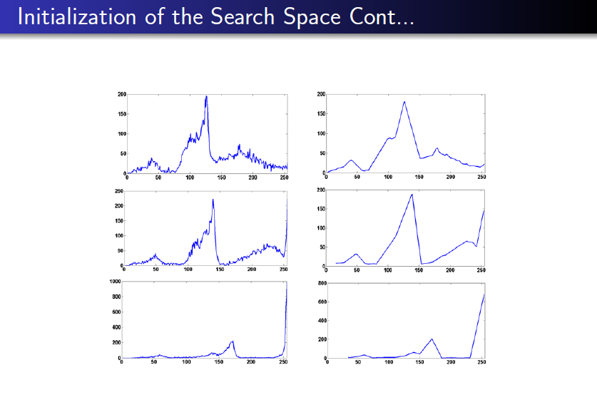
The first column shows the histograms of H, S and V components of the church image while the second column shows their dominating peaks

Slide 10
Each cluster centroid consists of three components H, S and V respectively.
In each chromosome the first three values represent the centroid of the first cluster, the second three values represent the centroid of second cluster and so on.
Suppose that K = 3, then a particular chromosome can be represented shown above:

Slide 14
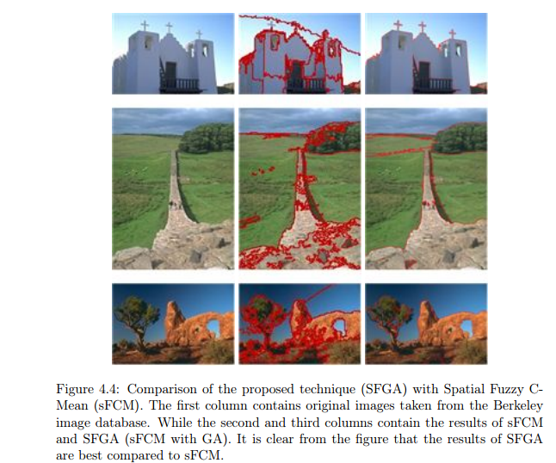
Comparison of sFCM VS SFGA

Slide 15
Pruning
In some cases the given Spatial Fuzzy Genetic Algorithm (SFGA) makes the small regions as separate segments, which leads to over-segmentation.
A simple mechanism is used to eliminate the small segments by merging to their matching neighbors.
The pseudo-code of the elimination process is given in Algorithm 3.

Slide 25
Thank you

